Slide 1



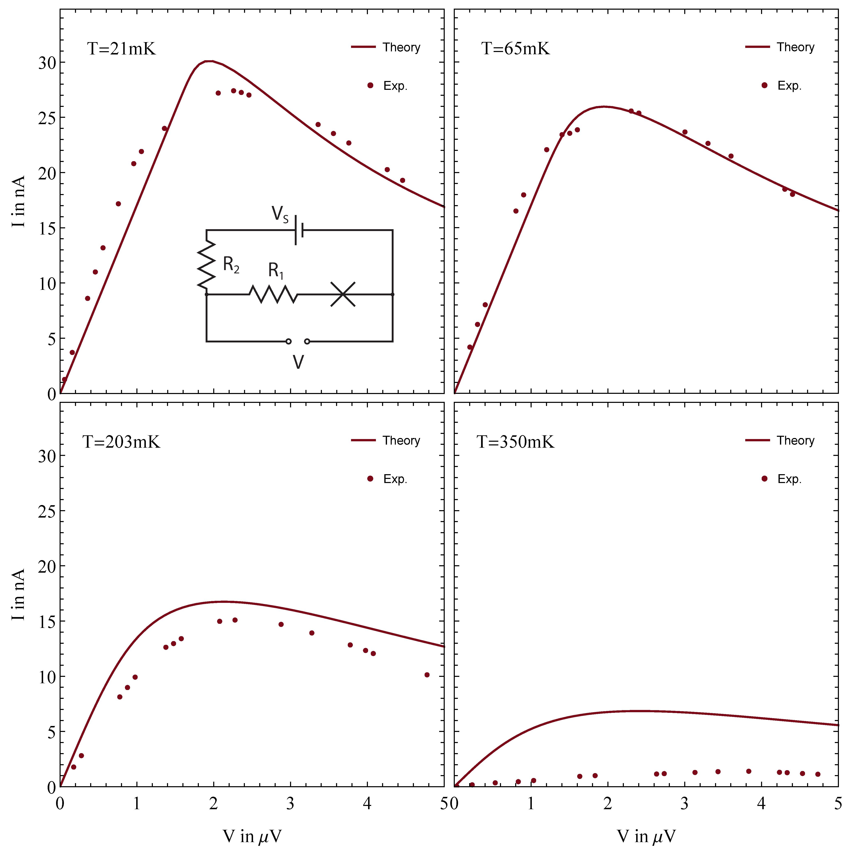
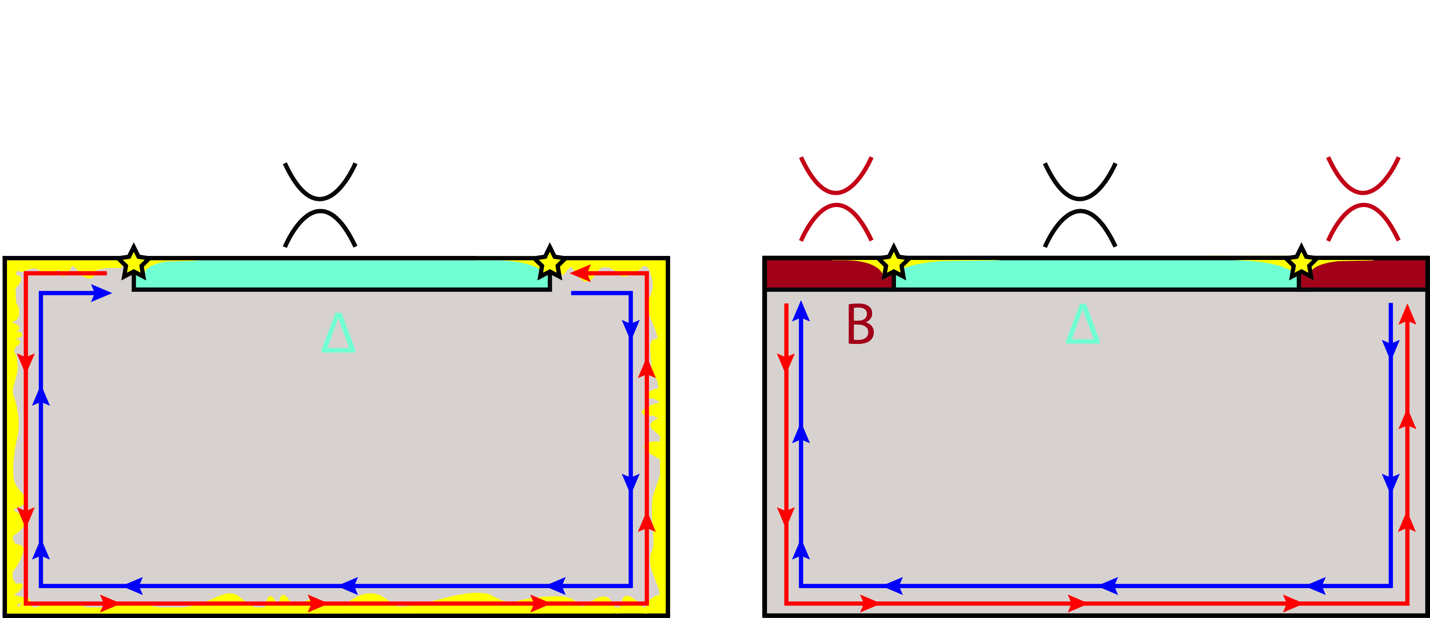
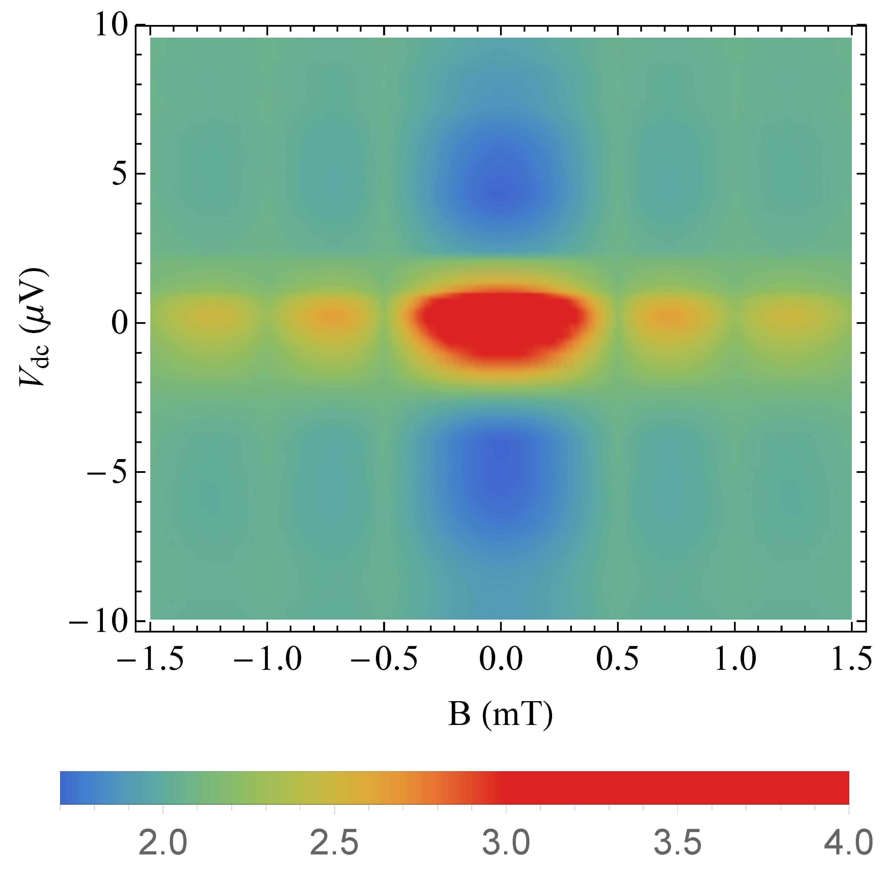
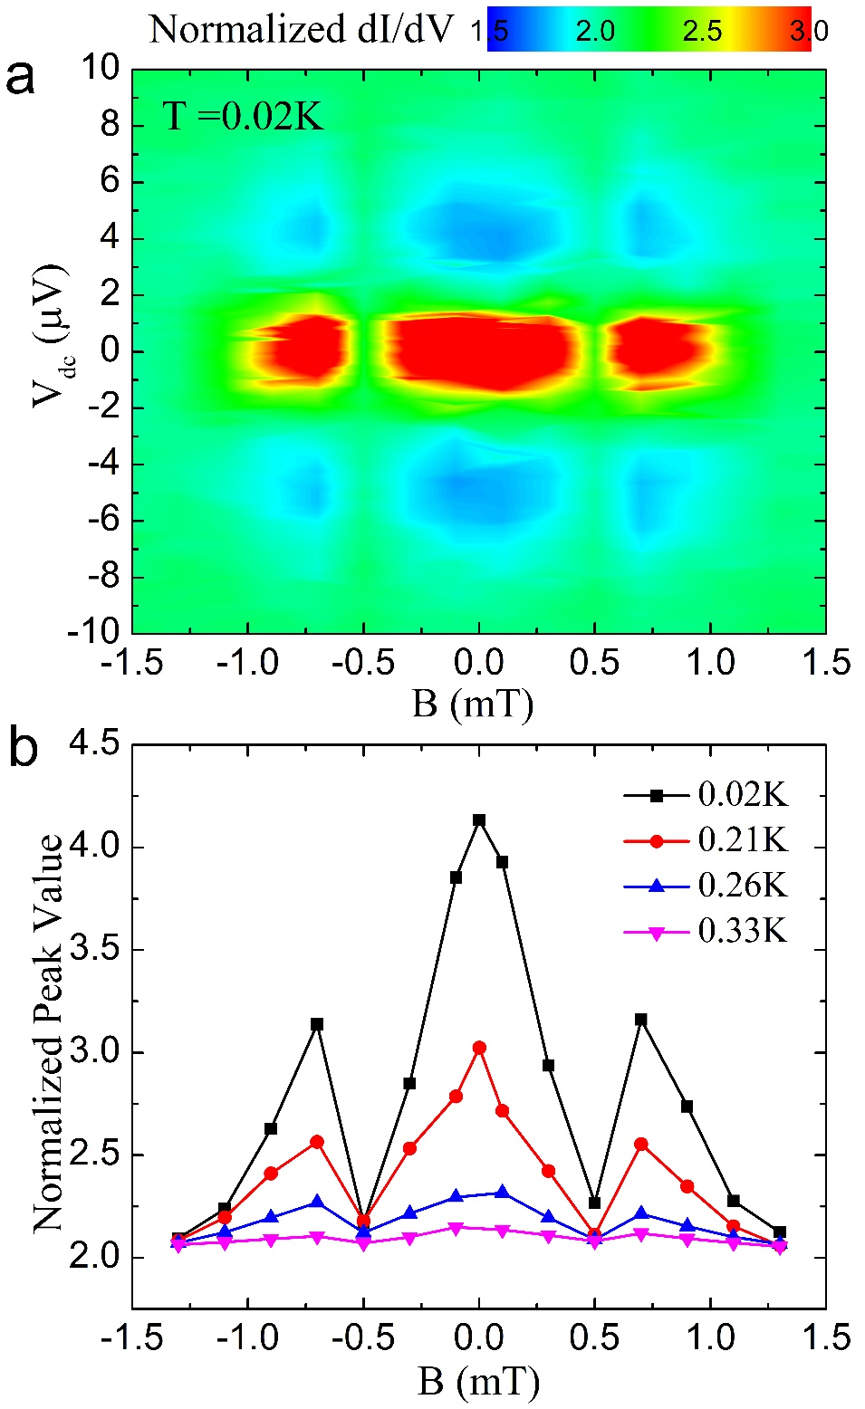
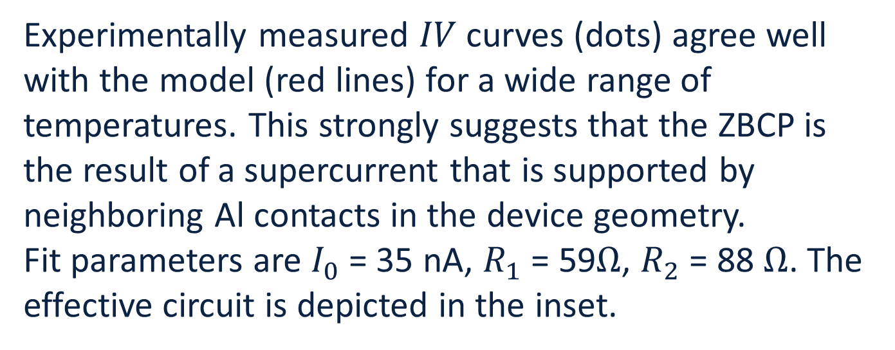
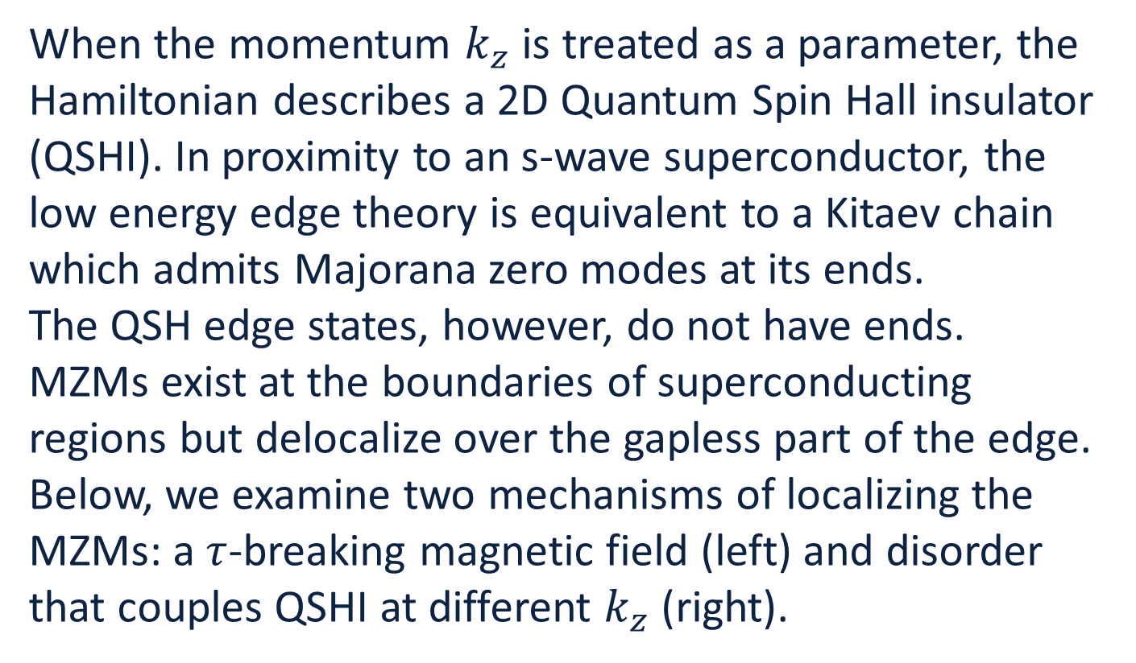
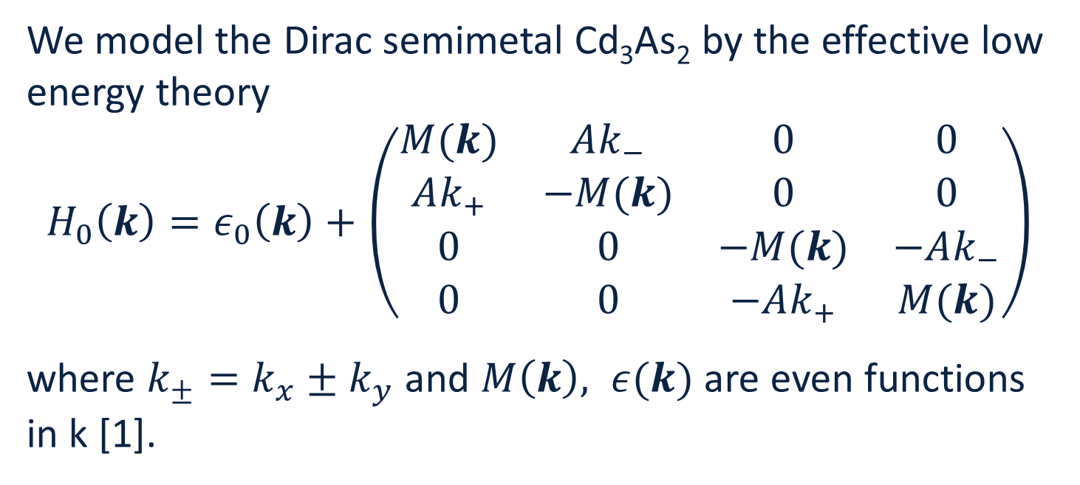
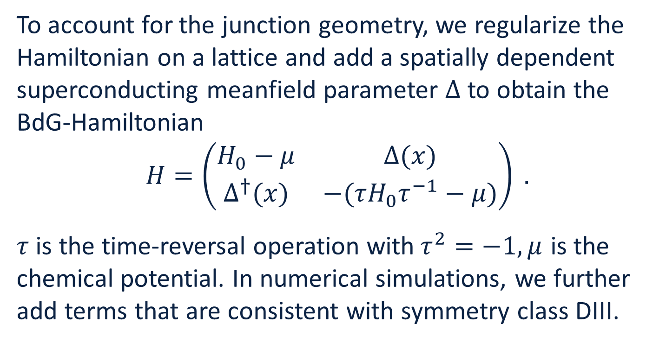
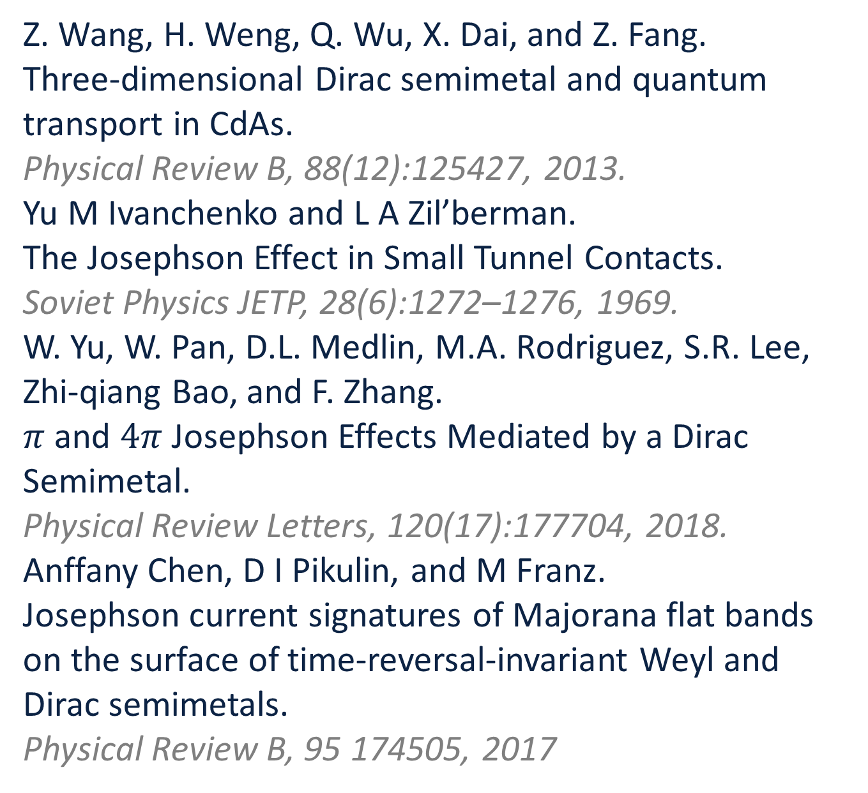
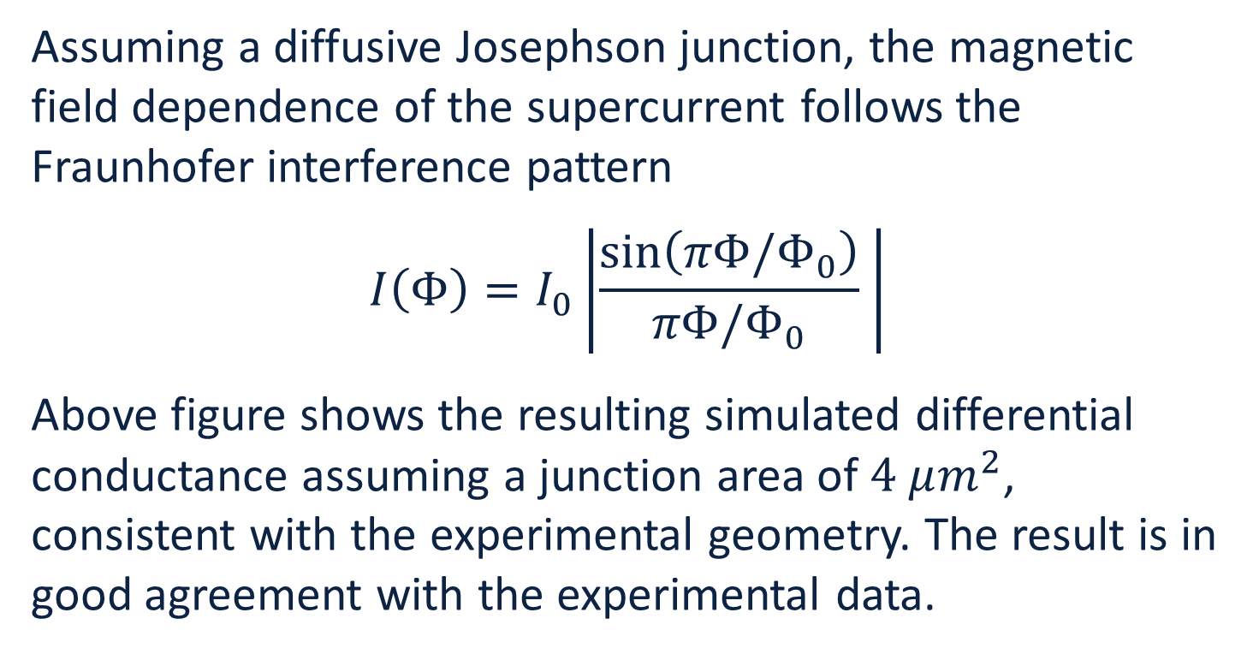
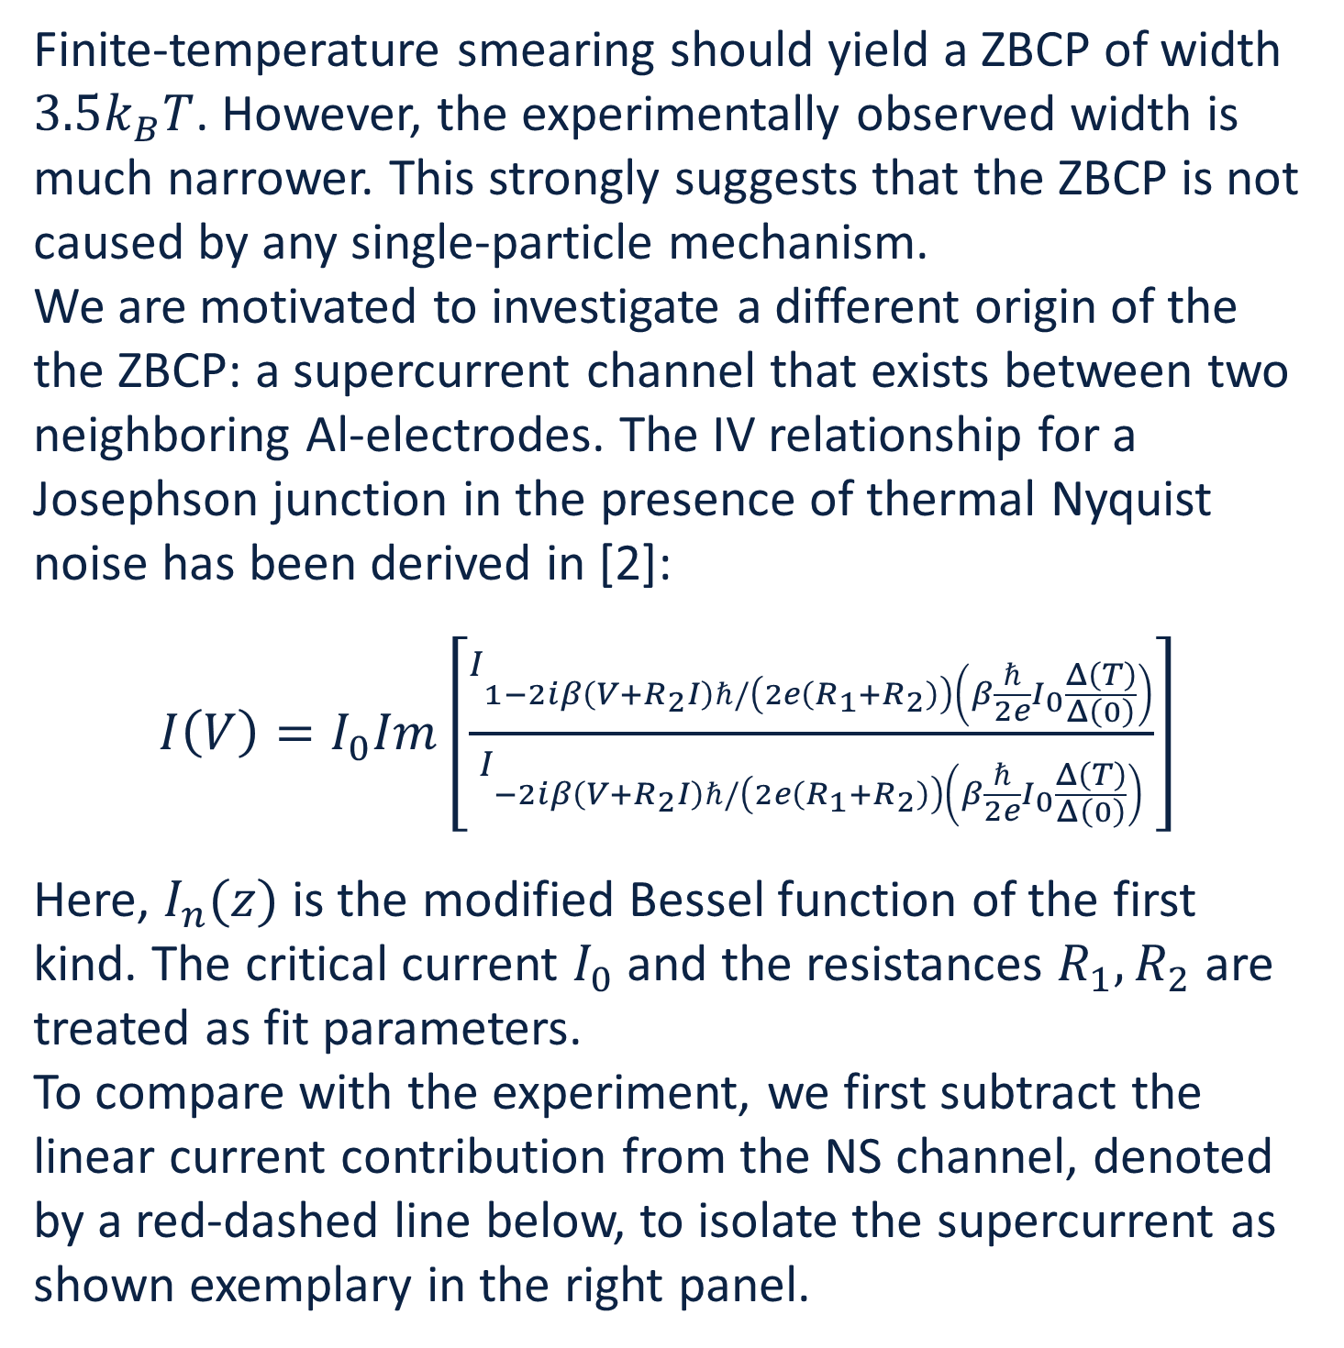
Large Zero Bias Conductance Peak
in Dirac Semimetal-Superconductor Devices
R. Haenel¹, W. Yu², M.A. Rodriguez², S.R. Lee², F. Zhang⁴, M. Franz¹, D. I. Pikulin⁵, and W. Pan^{2,3}
¹ Stewart Blusson Quantum Matter Institute, University of British Columbia, Vancouver
² Sandia National Laboratories, Albuquerque, New Mexico
³ Sandia National Laboratories, Livermore, California
⁴ University of Texas at Dallas
⁵ Microsoft Station Q, University of California, Santa Barbara
Summary
To account for the junction geometry, we regularize the Hamiltonian on a lattice and add a spatially dependent superconducting meanfield parameter $Δ$ to obtain the BdG-Hamiltonian
$$H=\left(\begin{matrix}H_{0}−μ & Δ(x) \\ Δ^{†}(x) & −(τH_{0}τ^{−1}−μ)\end{matrix}\right) .$$
$τ$ is the time-reversal operation with$τ^{2}=−1, μ$ is the chemical potential. In numerical simulations, we further add terms that are consistent with symmetry class DIII.
We report the observation of a large ZBCP in superconducting junction structures mediated by surface states of the Dirac semimetal Cd₃As₂. Our detailed analyses suggest that this large ZBCP is most likely not caused by MZMs. We attribute it, instead, to the existence of a supercurrent between two far-separated
superconducting Al electrodes.
Experimental results
Majorana Zero Modes
Majorana zero modes (MZMs) are widely seen as a promising route towards the realization of topological quantum computation. One of the experimental hallmarks of the presence of MZMs is a quantized zero bias conductance peak (ZBCP) in differential conductance measurements. Here, we report the observation of such a large ZBCP in transport measurements across a Ti/Au-Cd3As2-Al junction.
Below, we show the temperature and magnetic field dependence of the ZBCP. The data shown was measured on the rightmost junction.
Experimentally measured $IV$ curves (dots) agree well with the model (red lines) for a wide range of temperatures. This strongly suggests that the ZBCP is the result of a supercurrent that is supported by neighboring Al contacts in the device geometry.
Fit parameters are $I_{0}$ = 35 nA, $R_{1}$ = 59$Ω$, $R_{2}$ = 88 $Ω$. The effective circuit is depicted in the inset.
When the momentum $k_{z}$ is treated as a parameter, the Hamiltonian describes a 2D Quantum Spin Hall insulator (QSHI). In proximity to an s-wave superconductor, the low energy edge theory is equivalent to a Kitaev chain which admits Majorana zero modes at its ends.
The QSH edge states, however, do not have ends. MZMs exist at the boundaries of superconducting regions but delocalize over the gapless part of the edge.
Below, we examine two mechanisms of localizing the MZMs: a $τ$-breaking magnetic field (left) and disorder that couples QSHI at different $k_{z}$(right).
Magnetic field dependence
4.0
3.5
3.0
Heading: Calibri Bold 44pt
2.5
2.0
Model
ZBP from supercurrent
Assuming a diffusive Josephson junction, the magnetic field dependence of the supercurrent follows the Fraunhofer interference pattern
$$I\left(Φ\right)=I_{0}\left|\frac{sin\left(πΦ/Φ_{0}\right)}{πΦ/Φ_{0}} \right|$$
Above figure shows the resulting simulated differential conductance assuming a junction area of $4 μm^{2}$, consistent with the experimental geometry. The result is in good agreement with the experimental data.
We model the Dirac semimetal Cd₃As₂ by the effective low energy theory
$$H_{0}\left(k\right)=ε_{0}\left(k\right)+\left(\begin{matrix}M(k) & Ak_{−} & 0 & 0 \\ Ak_{+} & −M(k) & 0 & 0 \\ 0 & 0 & −M(k) & −Ak_{−} \\ 0 & 0 & −Ak_{+} & M(k)\end{matrix}\right)$$
where $k_{±}=k_{x}±k_{y}$ and $M\left(k\right), ε(k)$ are even functions in k [1].
Finite-temperature smearing should yield a ZBCP of width
$3.5k_{B}T$. However, the experimentally observed width is much narrower. This strongly suggests that the ZBCP is not caused by any single-particle mechanism.
We are motivated to investigate a different origin of the the ZBCP: a supercurrent channel that exists between two neighboring Al-electrodes. The IV relationship for a Josephson junction in the presence of thermal Nyquist noise has been derived in [2]:
$I\left(V\right)=I_{0}Im\left[\frac{I_{1−2iβ\left(V+R_{2}I\right)ℏ/\left(2e\left(R_{1}+R_{2}\right)\right)\left(β\frac{ℏ}{2e}I_{0}\frac{Δ\left(T\right)}{Δ\left(0\right)}\right)}}{I_{−2iβ\left(V+R_{2}I\right)ℏ/\left(2e\left(R_{1}+R_{2}\right)\right)\left(β\frac{ℏ}{2e}I_{0}\frac{Δ\left(T\right)}{Δ\left(0\right)}\right)}}\right]$
Here, $I_{n}(z)$ is the modified Bessel function of the first kind. The critical current $I_{0}$ and the resistances $R_{1}, R_{2}$ are treated as fit parameters.
To compare with the experiment, we first subtract the linear current contribution from the NS channel, denoted by a red-dashed line below, to isolate the supercurrent as shown exemplary in the right panel.
References
[1]
[1]
[2]
[3]
[4]
Z. Wang, H. Weng, Q. Wu, X. Dai, and Z. Fang.
Three-dimensional Dirac semimetal and quantum transport in CdAs.
Physical Review B, 88(12):125427, 2013.
Yu M Ivanchenko and L A Zil’berman.
The Josephson Effect in Small Tunnel Contacts.
Soviet Physics JETP, 28(6):1272–1276, 1969.
W. Yu, W. Pan, D.L. Medlin, M.A. Rodriguez, S.R. Lee, Zhi-qiang Bao, and F. Zhang.
$π$ and $4π$ Josephson Effects Mediated by a Dirac Semimetal.
Physical Review Letters, 120(17):177704, 2018.
Anffany Chen, D I Pikulin, and M Franz.
Josephson current signatures of Majorana flat bands on the surface of time-reversal-invariant Weyl and Dirac semimetals.
Physical Review B, 95 174505, 2017
[1] Z. Wang, H. Weng, Q. Wu, X. Dai, and Z. Fang.
Three-dimensional Dirac semimetal and quantum transport in CdAs.
Physical Review B, 88(12):125427, 2013.
[2] Yu M Ivanchenko and L A Zil’berman.
The Josephson Effect in Small Tunnel Contacts.
Soviet Physics JETP, 28(6):1272–1276, 1969.
[3] W. Yu, W. Pan, D.L. Medlin, M.A. Rodriguez, S.R. Lee, Zhi-qiang Bao,
and F. Zhang.
and 4 Josephson Effects Mediated by a Dirac Semimetal.
Physical Review Letters, 120(17):177704, apr 2018.
[4] Anffany Chen, D I Pikulin, and M Franz.
Josephson current signatures of Majorana flat bands on the surface of
time-reversal-invariant Weyl and Dirac semimetals.
174505:1–7, 2017.

